Slide 1


Team 71: Virtual Computer Mouse using mmWave Radar (TI) TI Presentation
Oscar Chavez Araiza
Greyson Heath
Daniel Lu
Zane Meikle
Sponsor: Texas Instruments
TA: Vishwam Raval

Slide 2
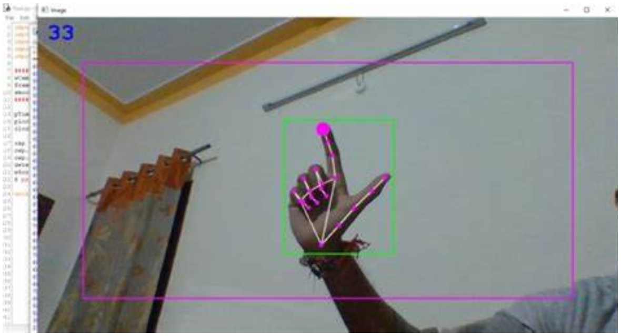
Project Summary:
Problem statement:
Virtual mice today are traditionally done using computer vision and a camera (as seen on the right).
But these systems are processing and power intensive.
High-level summary:
Create a virtual mouse using a Texas Instruments (TI) mmWave Radar and a ML model to make a less power and processing intensive virtual mouse.
#71 - Virtual Mouse using mmWave Radar (TI)

Slide 3
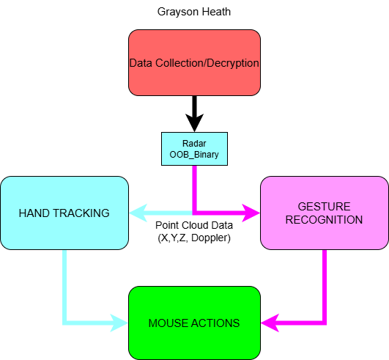
Integrated System Diagram
#71 - Virtual Mouse using mmWave Radar (TI)

Slide 4
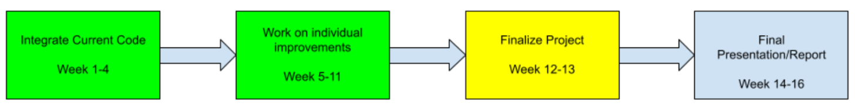
Project Timeline
#71 - Virtual Mouse using mmWave Radar (TI)

Slide 5
Chirp Config / Collect Data
Greyson Heath
Accomplishments since last update <10> hrs | Ongoing progress/problems and plans until the next presentation
<3> GUI Threaded <4> Case and Mount Adjustments/Print <2> Radar + Case and GUI Testing <1> Sponsor Alignment Meeting | Problems: GUI Gesture setting not actively changing the gesture. Not a GUI problem Plans: Will print a second case to have an additional on hand.
#71 - Virtual Mouse using mmWave Radar (TI)

Slide 6
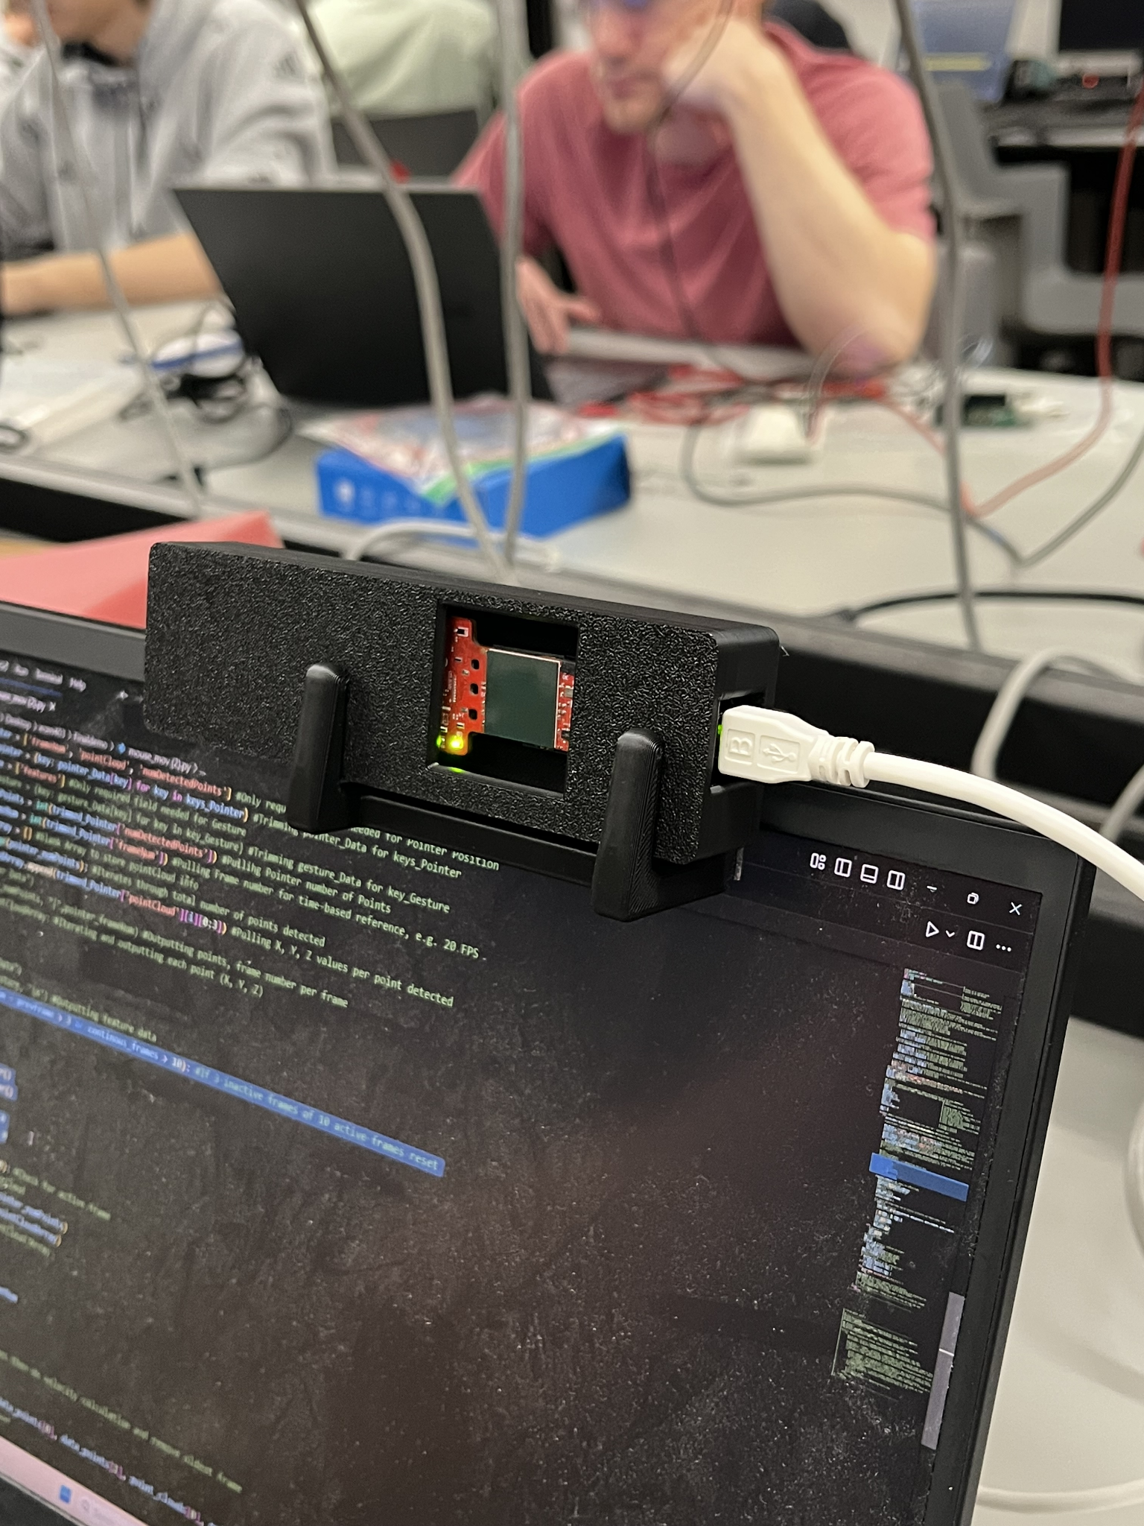
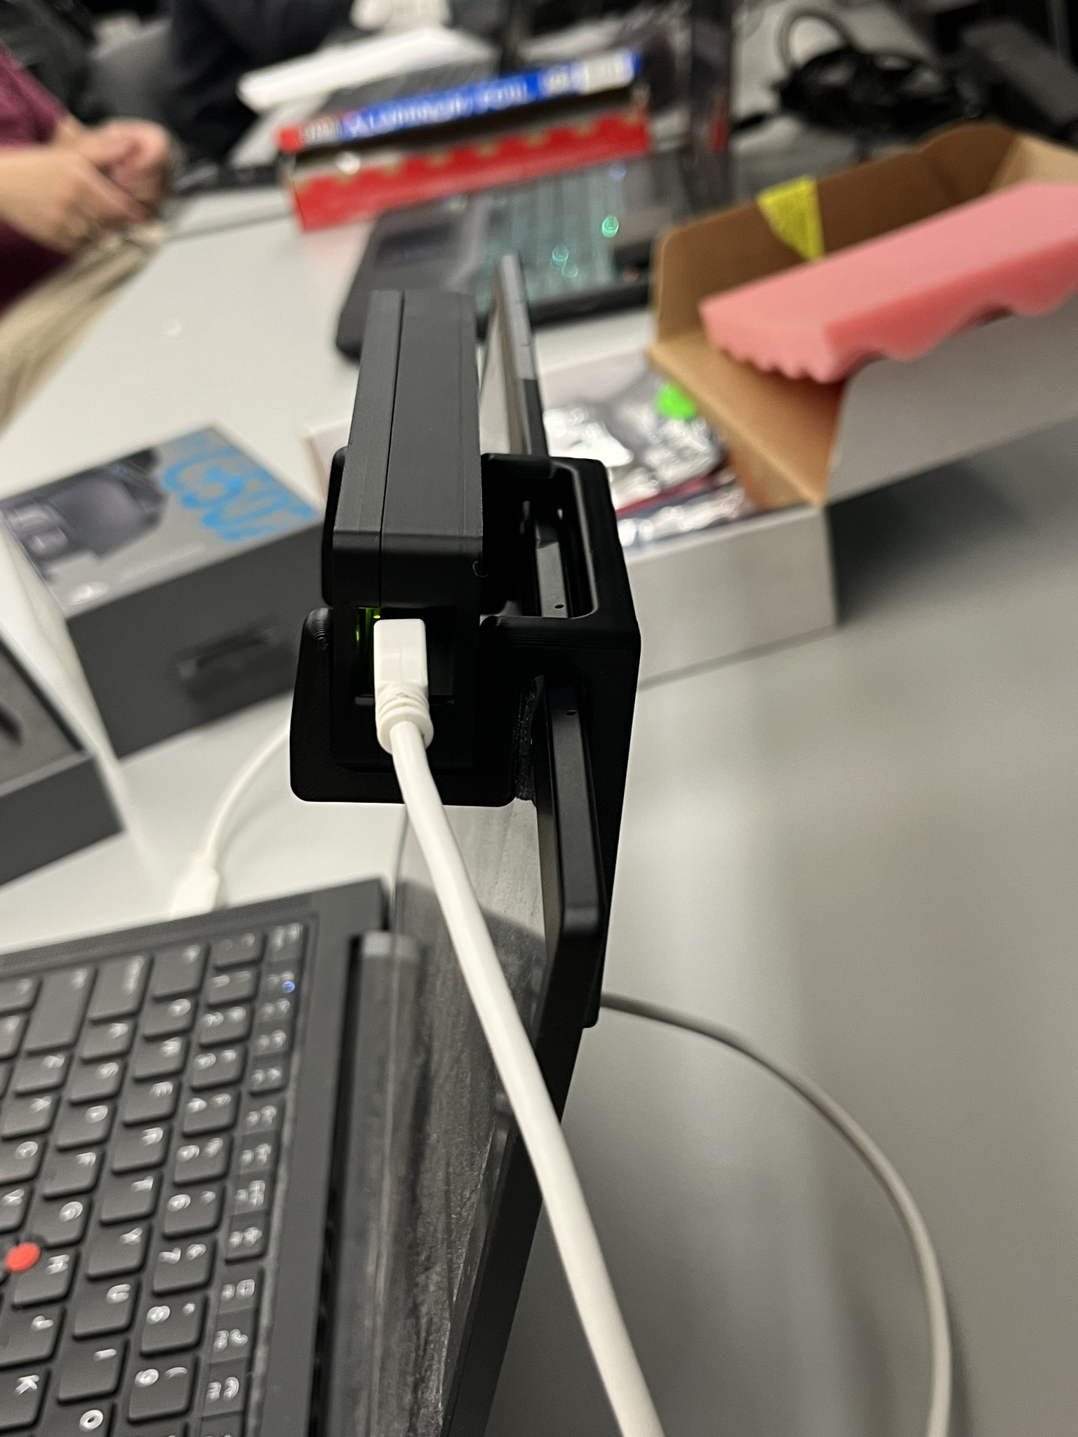
Final Radar Case
#71 - Virtual Mouse using mmWave Radar (TI)

Slide 7
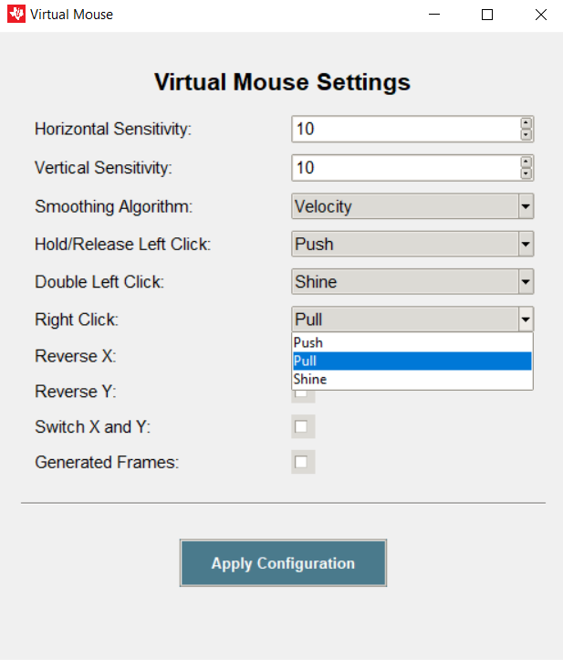
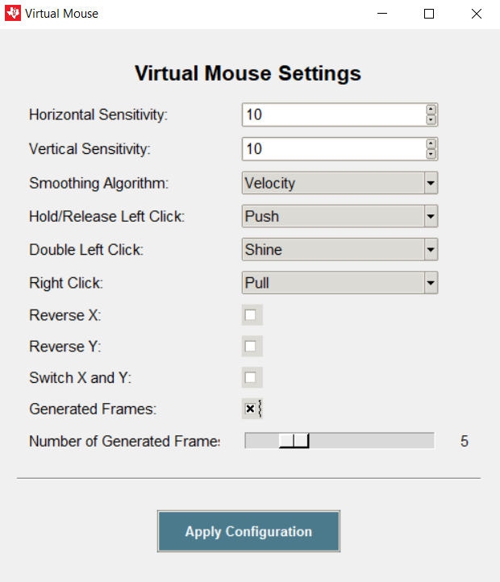
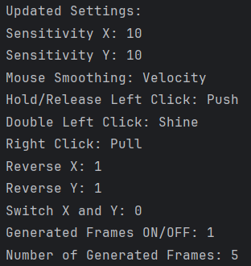
GUI Adjustments
Added
(Hidden)
(Not Hidden)
#71 - Virtual Mouse using mmWave Radar (TI)

Slide 8
-Gesture Recognition-
Oscar Chavez Araiza
Accomplishments since last update <~23> hrs | Ongoing progress/problems and plans until the next presentation
<1> Meeting with sponsor <8> Trained the model, and implemented it into the program. <10> Optimized Code for hand tracking <3> Commented and cleaned up overall code <1> Integrated Code into the final program | Problems Tracking background objects Miss-clicks Progress I have reduced the tracking area to avoid tracking background objects. Added more data to avoid Miss-Clicks
#71 - Virtual Mouse using mmWave Radar (TI)

Slide 9
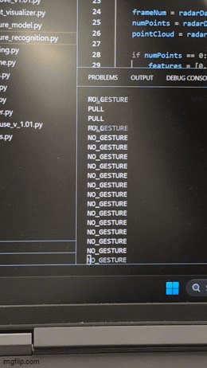
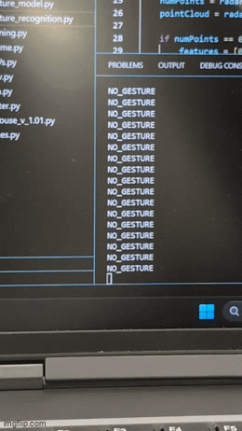
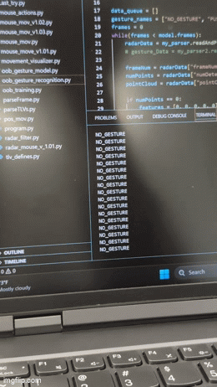
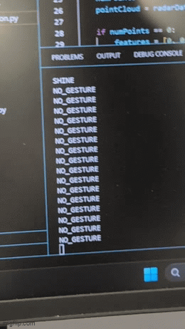
Gestures Recognized
PULL
PUSH
SHINE
SHAKE

Slide 10
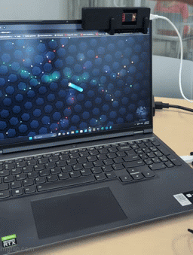
Using the radar to control a game

Slide 11
Gesture Positioning
Daniel Lu
Accomplishments since last update <10hr> | ECEN 404 ongoing progress/problems in the next 2 weeks
<4> Using k-mean clustering to tracking multiple objects in front of the radar <4> Working on the new tracking demo on the radar, analyzing more data points <1> meeting with sponsor | Problems: The movement of another hand will interact with the moving path. The user is expected to use another hand to give computer commands that are not included in the radar demo.
#71 - Virtual Mouse using mmWave Radar (TI)

Slide 12
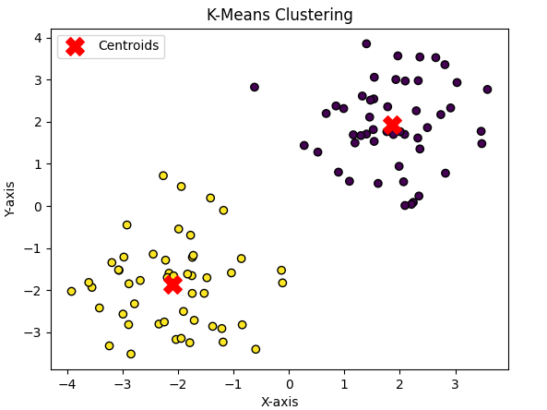
K-Mean Clustering

Slide 13
Input Mapping
Zane Meikle
Accomplishments since last update <8> hours | Ongoing progress/problems and plans until the next presentation
<1> meeting with sponsor <3> Integrate all current code <2> debugging GUI issue and fixing <2> adding more data for gestures | Problems: The gesture model needs more data to be more accurate Ongoing Progress: Working on adding data Plans: Work on adding more data and optimizing tracking.
#71 - Virtual Mouse using mmWave Radar (TI)

Slide 14
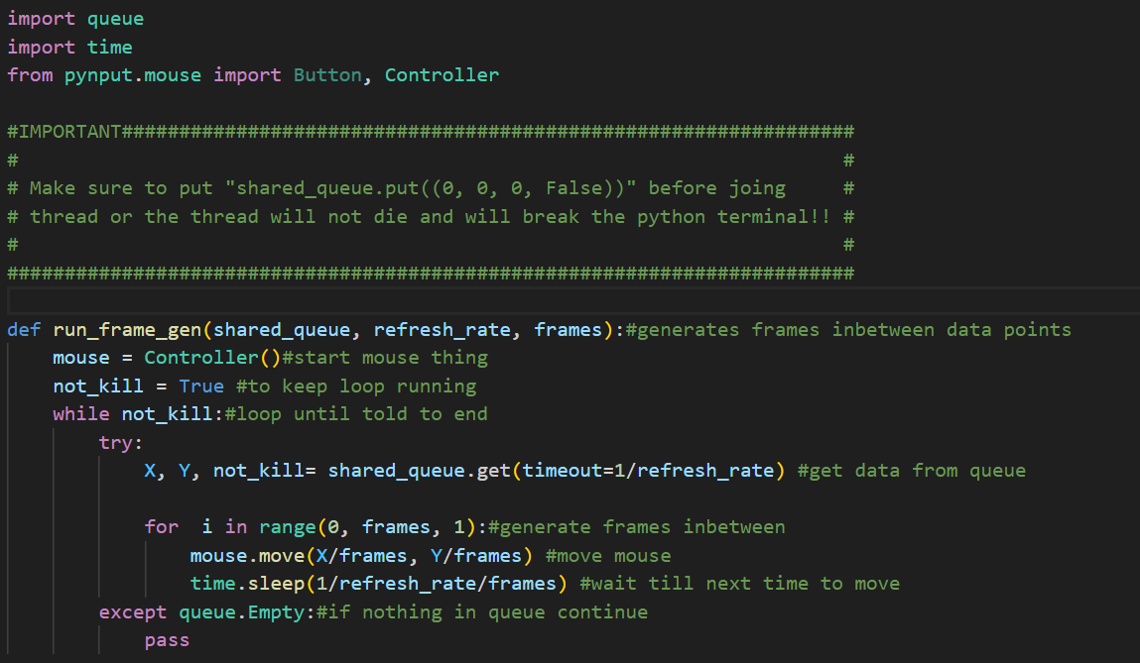
#71 - Virtual Mouse using mmWave Radar (TI)

Slide 15
Integrated System Results

Slide 16
Conclusions
(changes from FSR/ICD)
(Current status)

Slide 17
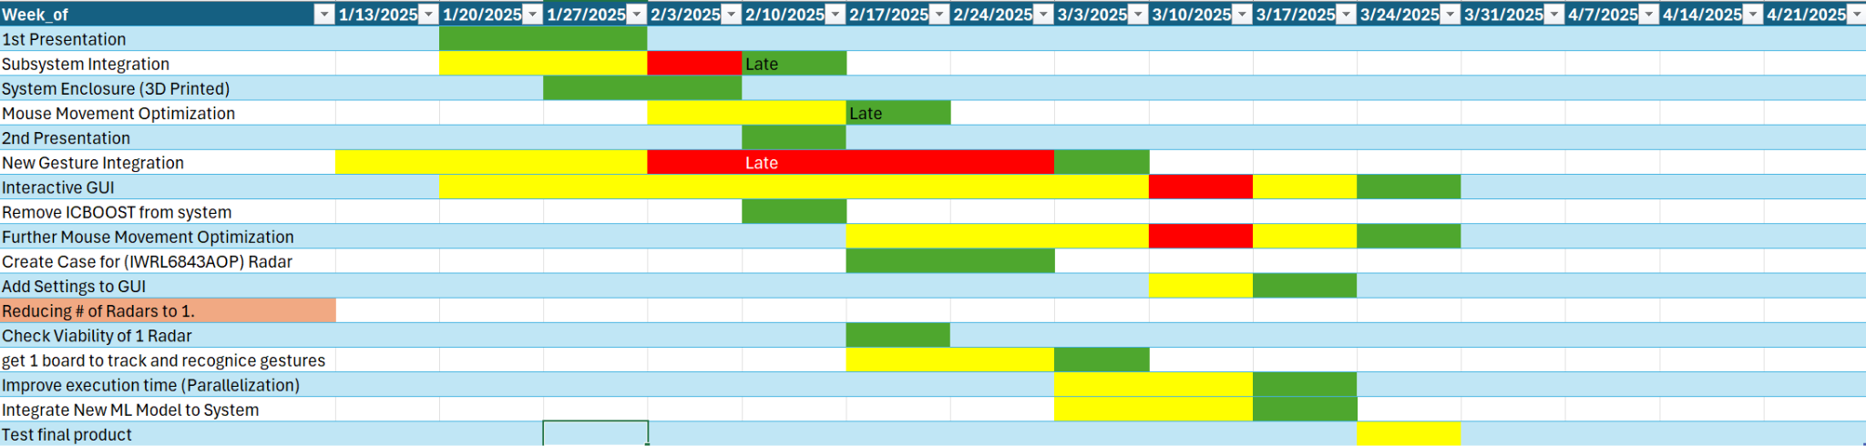
Execution Plan Gantt Chart
#71 - Virtual Mouse using mmWave Radar (TI)

Slide 18
Full System Validation
Task | Specification | Status | Owner
Gesture Recognition | The ML model must correctly identify gestures 95% of the time while integrated. | Failed | Oscar
Tracking | The program must be able to reliably track the hand. | Passed (Improvements were suggested) | Daniel
Frame Generation | The program must be able to correctly interpolate position, in order to add smoothing frames. | Passed | Zane
GUI | The user must be able to change all settings successfully using the program GUI | Passed | Grayson

Slide 19
Validation Plan
Section | Task | Specification | Result | Owner
3.2.1.6 | Mouse Movement | Mouse can be moved to all corners of the screen by the program. | Passed | Zane
3.2.1.6 | Mouse Actions | The program must be able to right click and left click. | Passed | Zane
3.2.5.2 | Mouse Input Error Handling | The program must properly handle all invalid inputs. | Passed | Zane
3.2.1.4 3.2.1.6 | Gesture positioning | The coordinates of the gesture should be calculated when deleting the error points. | Passed | Daniel
3.2.1.6 3.2.1.8 3.2.3.2.1 | Velocity accuracy | The output velocity of the moving gesture should not have errors. | Passed | Daniel
3.2.1.5 | Hand Gesture Recognition | ML model can recognize the users hand gestures | Passed | Oscar
#71 - Virtual Mouse using mmWave Radar (TI)

Slide 20
Validation Plan
Section | Task | Specification | Result | Owner
3.2.1.5 | Gesture Recognition Accuracy | ML model can correctly identify and categorize hand gestures at least 90% of the time. | Passed | Oscar
3.2.1.7 | Functional Radar System | The IWR6843AOPEVM properly communicates with the computer and transmits data. | Passed | Greyson
3.2.1.8 | Data Decoding | The python script accurately decodes the TLV data seen from both radars. | Passed | Greyson
3.2.1.3 3.2.1.4 | Radar Angle and Distance | The radars can capture gestures and pointer positions within a 90 degree range up to 1.5 feet | Passed | Greyson
3.2.1.5 | Hand Size | Radar will recognize gestures regardless of hand size. | Passed | Oscar
#71 - Virtual Mouse using mmWave Radar (TI)

Slide 21
That is all, thank you.

